Slide 1
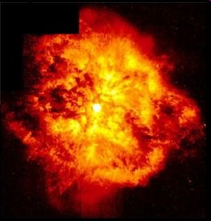
A star is simply
a ball of hot
burning gases.

Slide 2
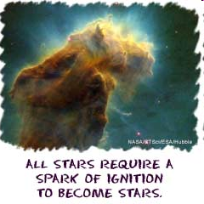

Slide 3
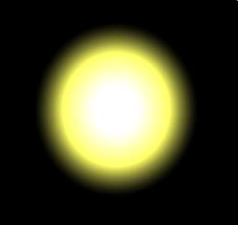
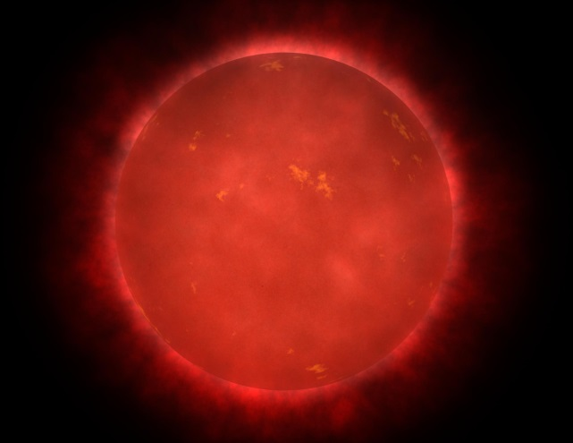
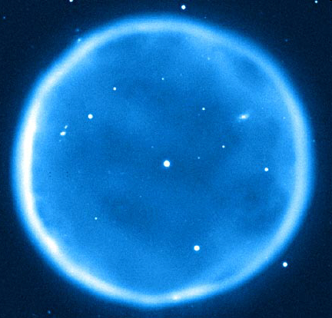
There are 3 colors of stars.
red
yellow
blue

Slide 4
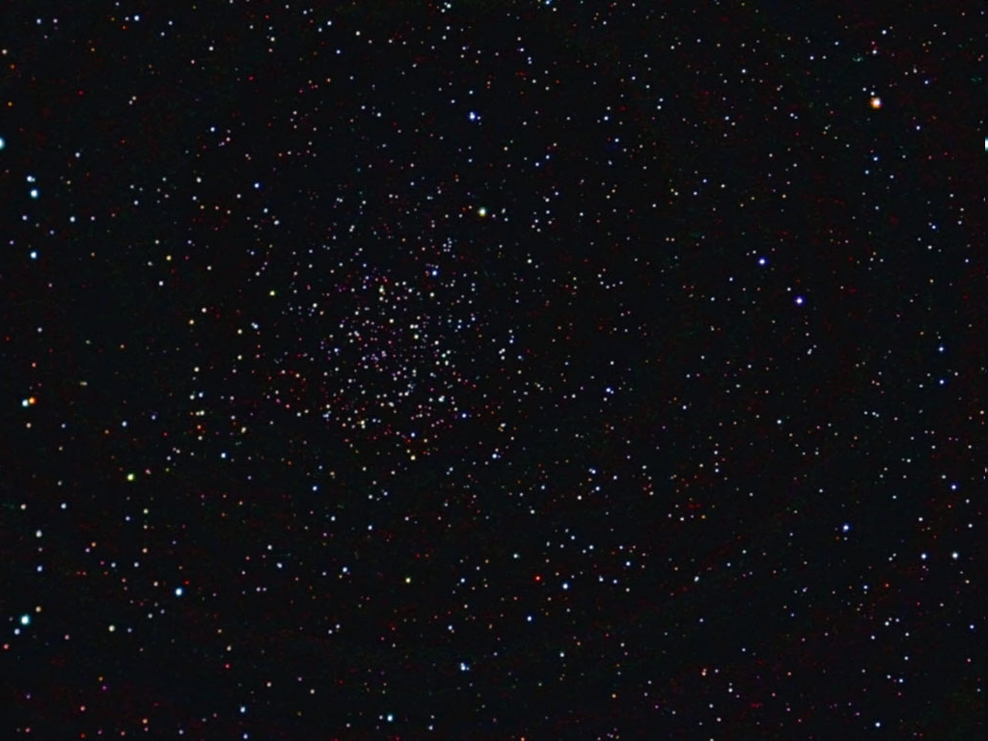
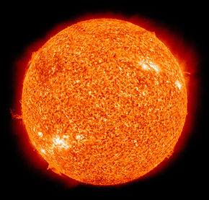
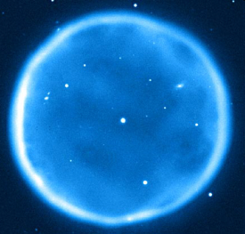
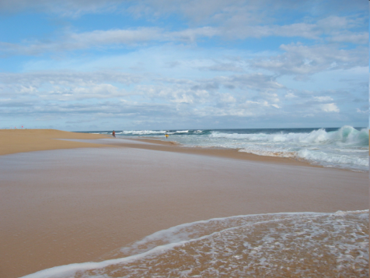
Star FACTS!
The closest star to
Earth is the Sun.
2. Stars do not move.
3. The hottest stars are
the blue stars.
Could you count all the
grains of sand on this beach….
4. How many stars do you
think there are?
…and on every other beach
in the world? There are
MORE stars than that!

