Slide 2
Video

Slide 8
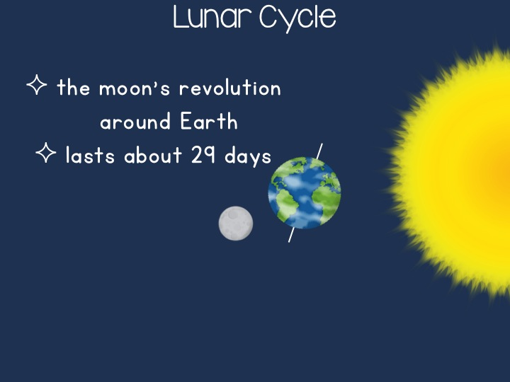

Slide 9
